Slide 1
Indexing

Slide 2
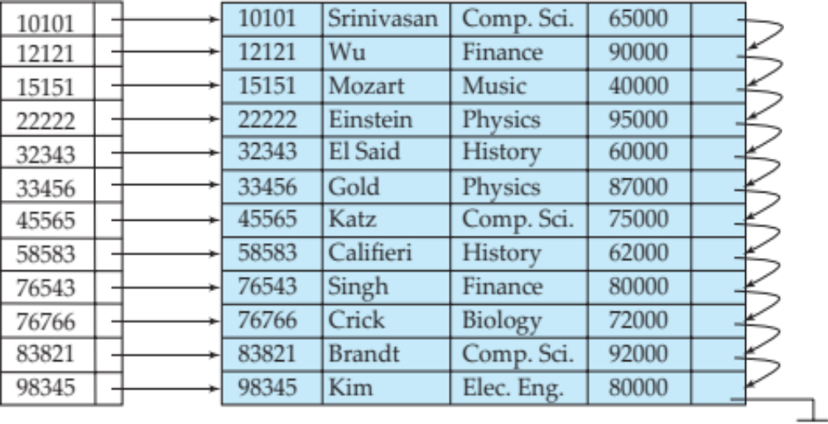
Basic Concepts
Indexing mechanisms used to speed up access to desired data.
Q1- Select * from instructor where id = 76766
Instructor relation and an index of instructor relation on id is given. Each record is stored in one block. How can the above query be executed
Without index (linear file scan)?
With using index?
Index
Question 8-1: index is kept in memory.
Explain best case and worst case of processing this query using linear scan.
In which case, this query will be faster using index?

Slide 3
Basic Concepts
Search Key - attribute or set of attributes used to look up records in a file.
Index on Id, search key is Id
Index on name, search key is name
Index on dept-name, search key is dept-name
Index

Slide 4
Basic Concepts
An index file consists of records (called index entries) of the form
search-key
pointer
Index

Slide 5
Basic Concepts
Index files are typically much smaller than the original file
Two basic kinds of indices:
  Ordered indices: search keys are stored in sorted order
  Hash indices: search keys are distributed uniformly across “buckets” using a “hash function”.
Index

Slide 6
Index Evaluation Metrics
Access types supported efficiently. E.g.,
  records with a specified value in the attribute e.g., Select * from instructor where id = 76766 (Point query)
  or records with an attribute value falling in a specified range of values. Select * from instructor where id >= 76766 (Range query)
Access time: Time to access a corresponding record for the given query
Insertion time: Time to insert a record into the relation including index entries
Deletion time: Time to delete a record from the relation including index deletions
Space overhead: Storage space needed for the index

Slide 7
Ordered Indices
In an ordered index, index entries are stored sorted on the search key value.
Primary index: in a sequentially ordered file, the index whose search key specifies the sequential order of the file.
  Also called clustering index
  The search key of a primary index is usually but not necessarily the primary key.
Index

Slide 8
Dense Index Files
Dense index — Index record appears for every search-key value in the file.
E.g. index on ID attribute of instructor relation

Slide 9
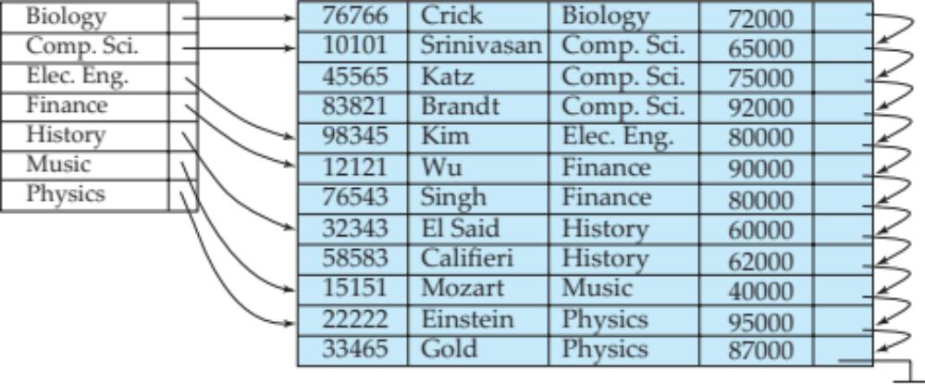
Dense Index Files (Cont.)
Dense index on dept_name, with instructor file sorted on dept_name

Slide 10
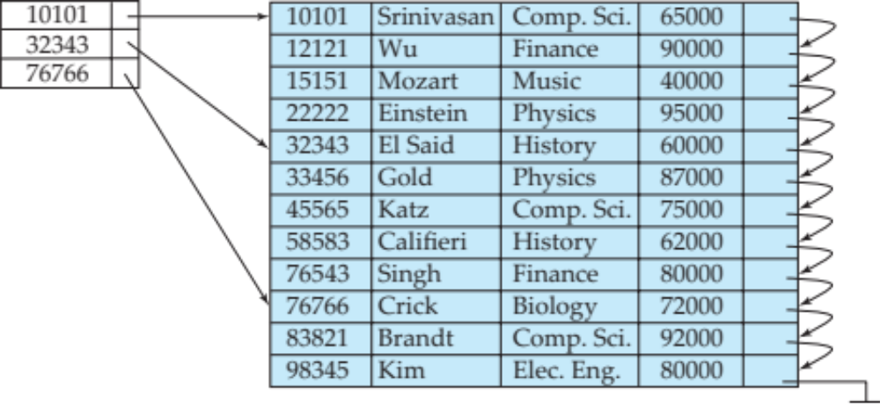
Sparse Index Files
Sparse Index: contains index records for only some search-key values.
  Applicable when records are sequentially ordered on search-key
To locate a record with search-key value K we:
  Find index record with largest search-key value < K
  Search file sequentially starting at the record to which the index record points
Question8-2: Explain how the following query will be executed using the given sparse index.
SELECT * FROM instructor WHERE id = 45565
Give a comparison between dense and sparse index

Slide 11
Sparse Index Files (Cont.)
Compared to dense indices:
  Less space and less maintenance overhead for insertions and deletions.
Example: insert into instructor values (12120, ‘Rafique’, ‘Physics’, 60000);
  Generally slower than dense index for locating records.
Example: SELECT * FROM instructor WHERE id = 76543

Slide 12
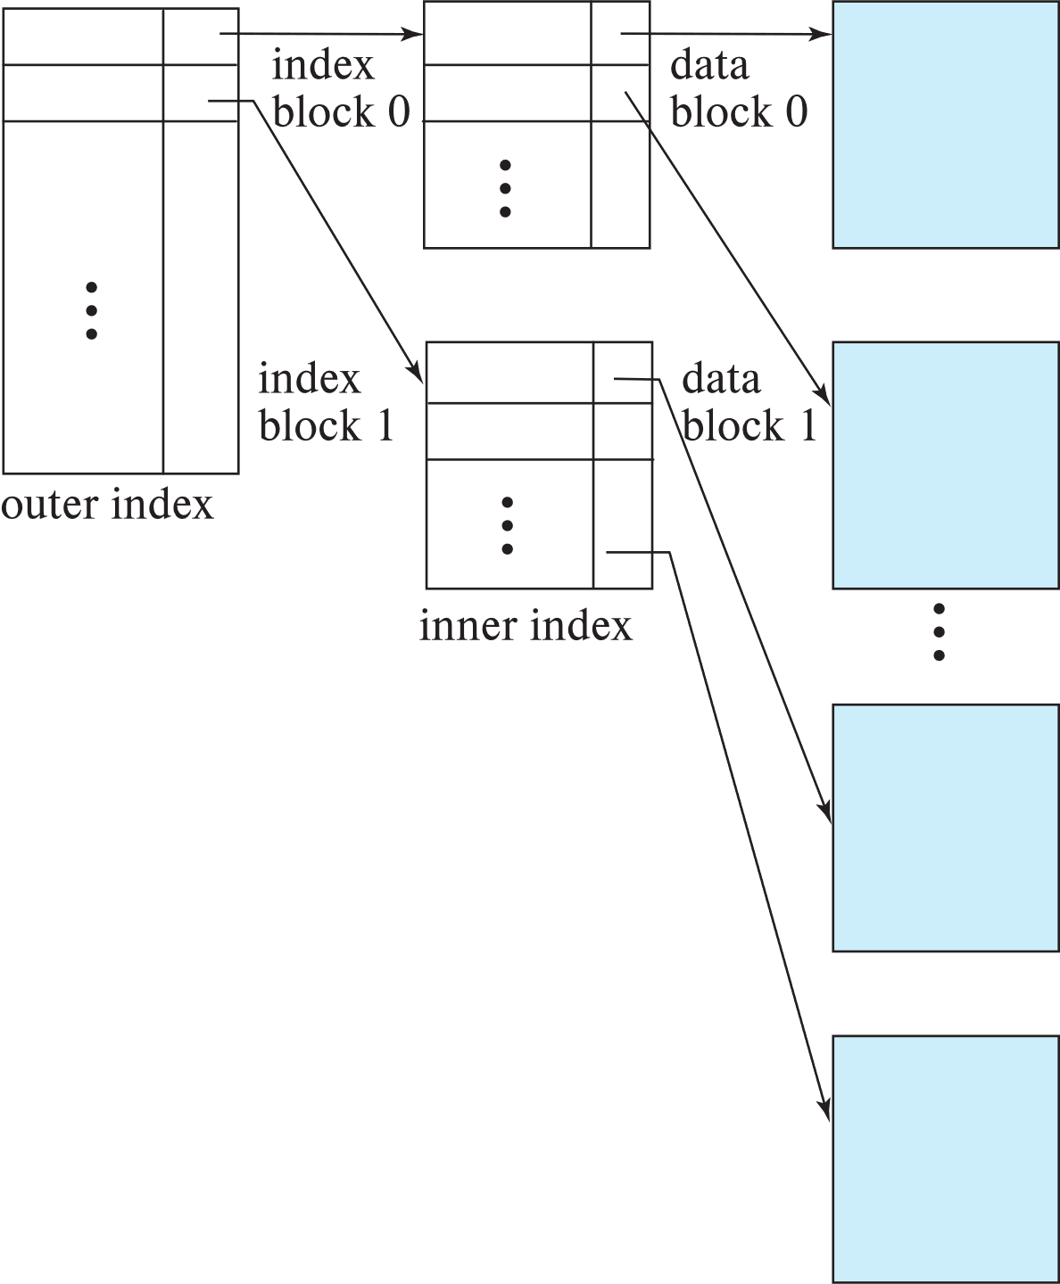

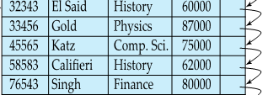
Sparse Index Files (Cont.)
Compared to dense indices:
  Less space and less maintenance overhead for insertions and deletions.
  Generally slower than dense index for locating records.
Good tradeoff:
  for clustered index: sparse index with an index entry for every block in file, corresponding to least search-key value in the block.
  For unclustered index: sparse index on top of dense index (multilevel index)

Slide 13

Secondary Indices
Secondary index: an index whose search key specifies an order different from the sequential order of the file. Also called
non-clustering index.
Index record points to a bucket that contains pointers to all the actual records with that particular search-key value.
Id name dept-name salary
Question 9-1: The primary index is given on id.
How many secondary index can be created for this relation?
Construct secondary index on dept-name. (Show only id and dept-name for the table)

Slide 14
Clustering vs Nonclustering Indices
Indices offer substantial benefits when searching for records.
BUT: indices imposes overhead on database modification
when a record is inserted or deleted, every index on the relation must be updated (Explain?)
Insert into instructor values (22225, ‘David’, ‘History’, 70000);
When a record is updated, any index on an updated attribute must be updated (Explain?)
Update instructor set salary = 50000 where id = 15151

Slide 15
Clustering vs Nonclustering Indices
Sequential scan using clustering index is efficient, but a sequential scan using a secondary (nonclustering) index is expensive on magnetic disk (Explain?)
Select * from instructor where salary <= 90000
  Each record access may fetch a new block from disk
  Each block fetch on magnetic disk requires about 5 to 10 milliseconds

Slide 16
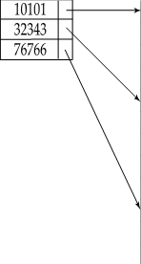
Multilevel Index
If index does not fit in memory, access becomes expensive. (Explain?)
Solution: treat index kept on disk as a sequential file (Index on id) and construct a sparse index on it.
  outer index – a sparse index of the basic index
  inner index – the basic index file
If even outer index is too large to fit in main memory, yet another level of index can be created, and so on.
Indices at all levels must be updated on insertion or deletion from the file.

Slide 17
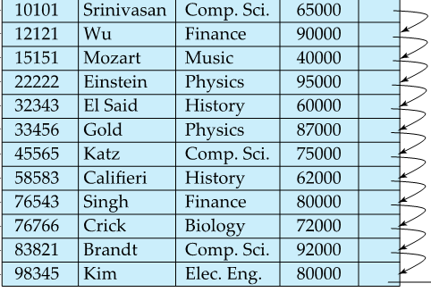
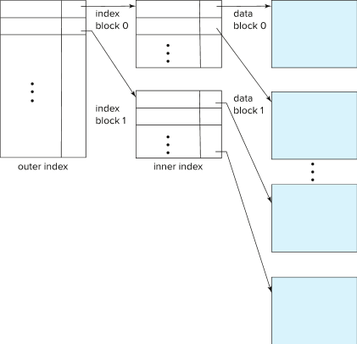



10101
10101
83821
22222
83821

Slide 18
Index Update: Deletion
If deleted record was the only record in the file with its particular search-key value, the search-key is deleted from the index also.
Single-level index entry deletion:
  Dense indices – deletion of search-key is similar to file record deletion.
  Delete from instructor where id = 22222
  Question 11-1 Write the algorithm for deletion in dense index

Slide 19
Index Update: Deletion
If deleted record was the only record in the file with its particular search-key value, the search-key is deleted from the index also.
Single-level index entry deletion:
  Sparse indices –
    if an entry for the search key exists in the index, it is deleted by replacing the entry in the index with the next search-key value in the file (in search-key order).
    If the next search-key value already has an index entry, the entry is deleted instead of being replaced.
  Delete from instructor where id = 22222
  Question 11-2 Write the algorithm for deletion in sparse index

Slide 20
Index Update: Insertion
Single-level index insertion:
  Perform a lookup using the search-key value of the record to be inserted.
  Dense indices – if the search-key value does not appear in the index, insert it
    Indices are maintained as sequential files
    Need to create space for new entry, overflow blocks may be required
Insert into instructor values (45566, ‘Karim’, ‘Physics’, 70000)
Question 11-3 Write the insertion algorithm for single level dense index

Slide 21
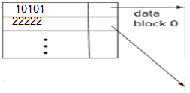
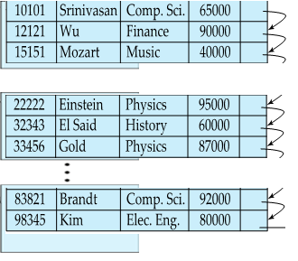
Index Update: Insertion
83821
Single-level index insertion:
  Perform a lookup using the search-key value of the record to be inserted.
  Sparse indices – if index stores an entry for each block of the file, no change needs to be made to the index unless a new block is created.
    If a new block is created, the first search-key value appearing in the new block is inserted into the index.
Assume 3 records per block.
Insert into instructor values (98400, ‘Abid’, ‘History’, 50000) * No need to add new block
Insert into instructor values (32400, ‘Atika’, ‘Comp. Sci’, 80000) * Need to add new block
Question 11-4 Write the insertion algorithm for single level sparse index

Slide 22
Index Update: Insertion
10101
22222
83821
Multilevel insertion and deletion: algorithms are simple extensions of the single-level algorithms
Assume 3 records per block.
Insert into instructor values (98400, ‘Abid’, ‘History’, 50000)
Insert into instructor values (32400, ‘Atika’, ‘Comp. Sci’, 80000)
Assignment part 1/1 Write the deletion/ insertion algorithms for multi level index with an example of 4 levels for NID database with 160 million records. Block size is 16KB and each block may contain 16 NID records and 800 index records.

Slide 23


Indices on Multiple Keys
Composite search key
  E.g., index on instructor relation on attributes (name, ID)
  Values are sorted lexicographically
    E.g. (John, 12121) < (John, 13514) and
    (John, 13514) < (Peter, 11223)
  Can query on just name, or on (name, ID)
Composite index (name, dept-name) search keys
SELECT *
FROM instructor
WHERE name = ‘Gold’ AND dept-name = ‘Physics’
Question 12-1:
There are 460 thanas and 64 districts.
Find the number of search keys of (than, district) composite index and thana simple index.
Query: select * from person where thana = ‘Sadar’ and district = ‘Sylhet’
Compare query performance using composite index and simple index

Slide 24
B⁺-Tree Index Files
Disadvantage of indexed-sequential files
  Performance degrades as file grows, since many overflow blocks get created (How?).
  Periodic reorganization of entire file is required.
10101
22222
83821

Slide 25
B⁺-Tree Index Files
Advantage of B⁺-tree index files:
  Automatically reorganizes itself with small, local, changes, in the face of insertions and deletions.
  Reorganization of entire file is not required to maintain performance.
(Minor) disadvantage of B⁺-trees:
  Extra insertion and deletion overhead, space overhead.
Advantages of B⁺-trees outweigh disadvantages
  B⁺-trees are used extensively

Slide 26
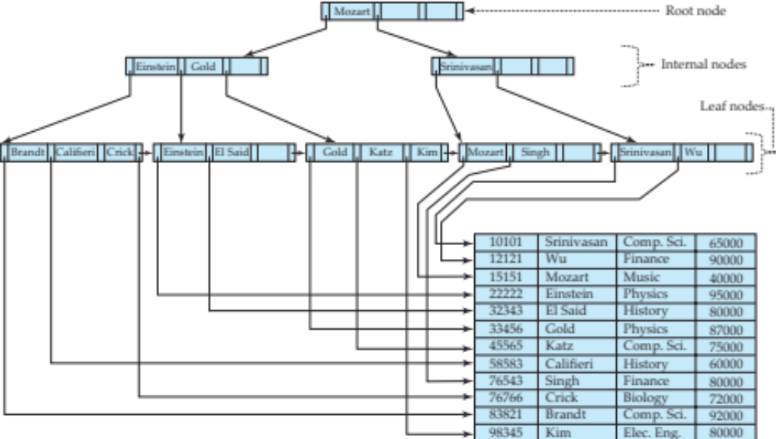
B⁺-Tree Index Files (Cont.)
A B⁺-tree is a rooted tree satisfying the following properties:
All paths from root to leaf are of the same length
Each node that is not a root or a leaf has between ⎡n/2⎤ and n children.
A leaf node has between ⎡(n–1)/2⎤ and n–1 values

Slide 27
B⁺-Tree Index Files (Cont.)
A B⁺-tree is a rooted tree satisfying the following properties:
Special cases:
  If the root is not a leaf, it has at least 2 children.
  If the root is a leaf (that is, there are no other nodes in the tree), it can have between 0 and (n–1) values.
Question 12-2: Find the minimum and maximum number of search keys in root, leaf and non-leaf nodes in B+ tree index structure with n = 99.

Slide 28
B⁺-Tree Node Structure
Typical node
  K_{i} are the search-key values
  P_{i} are pointers to children (for non-leaf nodes) or pointers to records or buckets of records (for leaf nodes).
The search-keys in a node are ordered
K₁ < K₂ < K₃ < . . . < K_{n–1}

Slide 29
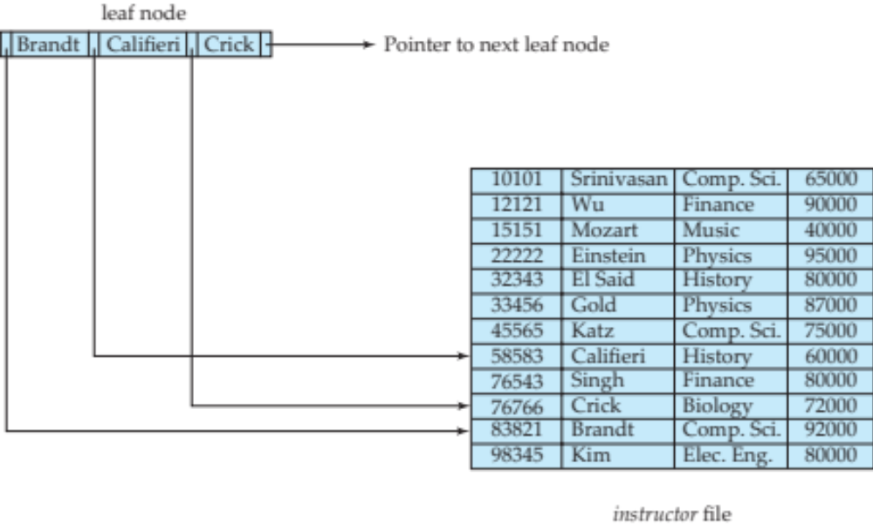
Leaf Nodes in B⁺-Trees
Properties of a leaf node:
For i = 1, 2, . . ., n–1, pointer P_{i} points to a file record with search-key value K_{i},
If L_{i}, L_{j} are leaf nodes and i < j, L_{i}’s search-key values are less than or equal to L_{j}’s search-key values
P_{n} points to next leaf node in search-key order

Slide 30
Non-Leaf Nodes in B⁺-Trees
Non leaf nodes form a multi-level sparse index on the leaf nodes. For a non-leaf node with m pointers:
  All the search-keys in the subtree to which P₁ points are less than K₁
  For 2 ≤ i ≤ n – 1, all the search-keys in the subtree to which P_{i} points have values greater than or equal to K_{i–1} and less than K_{i}
  All the search-keys in the subtree to which P_{n} points have values greater than or equal to K_{n–1}
  General structure

Slide 31
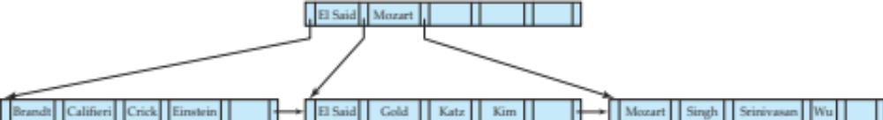
Example of B⁺-tree
B⁺-tree for instructor file (n = 6)
Leaf nodes must have between 3 and 5 values
(⎡(n–1)/2⎤ and n –1, with n = 6).
Non-leaf nodes other than root must have between 3 and 6 children (⎡(n/2⎤ and n with n =6).
Root must have at least 2 children.

Slide 32
Observations about B⁺-trees
Since the inter-node connections are done by pointers, “logically” close blocks need not be “physically” close.
The non-leaf levels of the B⁺-tree form a hierarchy of sparse indices.
The B⁺-tree contains a relatively small number of levels
    Level below root has at least 2* ⎡n/2⎤ values
    Next level has at least 2* ⎡n/2⎤ * ⎡n/2⎤ values
    .. etc.
  If there are K search-key values in the file, the tree height is no more than ⎡ log_{⎡n/2⎤}(K)⎤
  thus searches can be conducted efficiently.
Insertions and deletions to the main file can be handled efficiently, as the index can be restructured in logarithmic time (as we shall see).

Slide 33
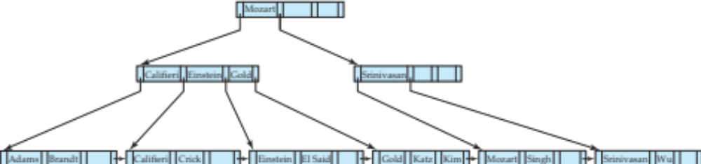
Queries on B⁺-Trees
function find(v)
  1. C=root
  2. while (C is not a leaf node)
    Let i be least number s.t. V ≤ K_{i}.
    if there is no such number i then
    Set C = last non-null pointer in C
    else if (v = C.K_{i} ) Set C = P_{i +1}
    else set C = C.P_{i}
  3. if for some i, K_{i} = V then return C.P_{i}
  4. else return null /* no record with search-key value v exists. */

Slide 34
Queries on B⁺-Trees (Cont.)
Range queries find all records with search key values in a given range
  See book for details of function findRange(lb, ub) which returns set of all such records
  Real implementations usually provide an iterator interface to fetch matching records one at a time, using a next() function

Slide 35
Queries on B⁺⁻Trees (Cont.)
If there are K search-key values in the file, the height of the tree is no more than ⎡log_{⎡n/2⎤}(K)⎤.
A node is generally the same size as a disk block, typically 4 kilobytes
  and n is typically around 100 (40 bytes per index entry).
With 1 million search key values and n = 100
  at most log₅₀(1,000,000) = 4 nodes are accessed in a lookup traversal from root to leaf.
Contrast this with a balanced binary tree with 1 million search key values — around 20 nodes are accessed in a lookup
  above difference is significant since every node access may need a disk I/O, costing around 20 milliseconds

Slide 36
Non-Unique Keys
If a search key a_{i} is not unique, create instead an index on a composite key (a_{i} , A_{p}), which is unique
  A_{p} could be a primary key, record ID, or any other attribute that guarantees uniqueness
Search for a_{i} = v can be implemented by a range search on composite key, with range (v, - ∞) to (v, + ∞)
But more I/O operations are needed to fetch the actual records
  If the index is clustering, all accesses are sequential
  If the index is non-clustering, each record access may need an I/O operation

Slide 37
Updates on B⁺-Trees: Insertion
Assume record already added to the file. Let
  pr be pointer to the record, and let
  v be the search key value of the record
Find the leaf node in which the search-key value would appear
  If there is room in the leaf node, insert (v, pr) pair in the leaf node
  Otherwise, split the node (along with the new (v, pr) entry) as discussed in the next slide, and propagate updates to parent nodes.

Slide 38
Updates on B⁺-Trees: Insertion (Cont.)
Splitting a leaf node:
  take the n (search-key value, pointer) pairs (including the one being inserted) in sorted order. Place the first ⎡n/2⎤ in the original node, and the rest in a new node.
  let the new node be p, and let k be the least key value in p. Insert (k,p) in the parent of the node being split.
  If the parent is full, split it and propagate the split further up.
Splitting of nodes proceeds upwards till a node that is not full is found.
  In the worst case the root node may be split increasing the height of the tree by 1.
Result of splitting node containing Brandt, Califieri and Crick on inserting Adams
Next step: insert entry with (Califieri, pointer-to-new-node) into parent

Slide 39
B⁺-Tree Insertion
Affected nodes
B⁺-Tree before and after insertion of “Adams”

Slide 40
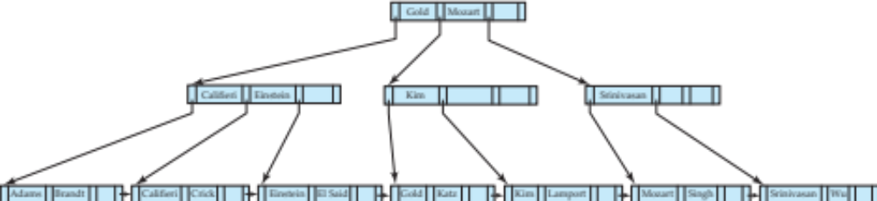
B⁺-Tree Insertion
B⁺-Tree before and after insertion of “Lamport”
Affected nodes
Affected nodes

Slide 41
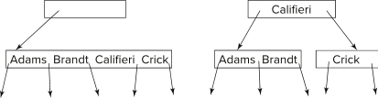
Insertion in B⁺-Trees (Cont.)
Splitting a non-leaf node: when inserting (k,p) into an already full internal node N
  Copy N to an in-memory area M with space for n+1 pointers and n keys
  Insert (k,p) into M
  Copy P₁,K₁, …, K _{⎡n/2⎤-1},P _{⎡n/2⎤} from M back into node N
  Copy P_{⎡n/2⎤+1},K _{⎡n/2⎤+1},…,K_{n},P_{n+1} from M into newly allocated node N'
  Insert (K _{⎡n/2⎤},N') into parent N
Example
Read pseudocode in book!

Slide 42
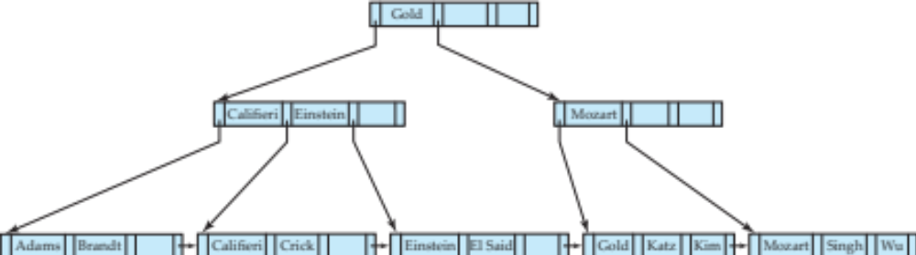
Examples of B⁺-Tree Deletion
Before and after deleting “Srinivasan”
Affected nodes
Deleting “Srinivasan” causes merging of under-full leaves

Slide 43
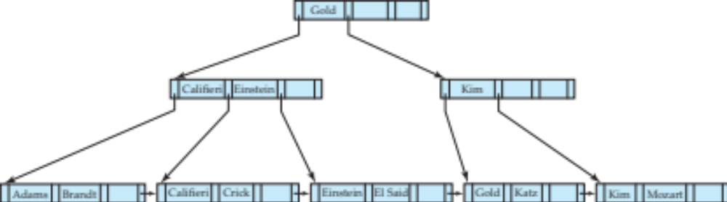
Examples of B⁺-Tree Deletion (Cont.)
Before and after deleting “Singh” and “Wu”
Affected nodes
Leaf containing Singh and Wu became underfull, and borrowed a value Kim from its left sibling
Search-key value in the parent changes as a result

Slide 44
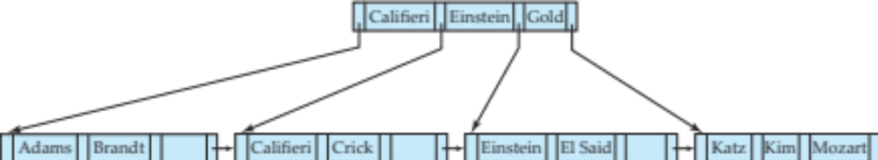
Example of B⁺-tree Deletion (Cont.)
Before and after deletion of “Gold”
Node with Gold and Katz became underfull, and was merged with its sibling
Parent node becomes underfull, and is merged with its sibling
  Value separating two nodes (at the parent) is pulled down when merging
Root node then has only one child, and is deleted

Slide 45
Updates on B⁺-Trees: Deletion
Assume record already deleted from file. Let V be the search key value of the record, and Pr be the pointer to the record.
Remove (Pr, V) from the leaf node
If the node has too few entries due to the removal, and the entries in the node and a sibling fit into a single node, then merge siblings:
  Insert all the search-key values in the two nodes into a single node (the one on the left), and delete the other node.
  Delete the pair (K_{i–1}, P_{i}), where P_{i} is the pointer to the deleted node, from its parent, recursively using the above procedure.

Slide 46
Updates on B⁺-Trees: Deletion
Otherwise, if the node has too few entries due to the removal, but the entries in the node and a sibling do not fit into a single node, then redistribute pointers:
  Redistribute the pointers between the node and a sibling such that both have more than the minimum number of entries.
  Update the corresponding search-key value in the parent of the node.
The node deletions may cascade upwards till a node which has ⎡n/2⎤ or more pointers is found.
If the root node has only one pointer after deletion, it is deleted and the sole child becomes the root.

Slide 47
Complexity of Updates
Cost (in terms of number of I/O operations) of insertion and deletion of a single entry proportional to height of the tree
  With K entries and maximum fanout of n, worst case complexity of insert/delete of an entry is O(log_{⎡n/2⎤}(K))
In practice, number of I/O operations is less:
  Internal nodes tend to be in buffer
  Splits/merges are rare, most insert/delete operations only affect a leaf node
Average node occupancy depends on insertion order
  2/3rds with random, ½ with insertion in sorted order

Slide 48
Non-Unique Search Keys
Alternatives to scheme described earlier
  Buckets on separate block (bad idea)
  List of tuple pointers with each key
    Extra code to handle long lists
    Deletion of a tuple can be expensive if there are many duplicates on search key (why?)
      Worst case complexity may be linear!
    Low space overhead, no extra cost for queries
  Make search key unique by adding a record-identifier
    Extra storage overhead for keys
    Simpler code for insertion/deletion
    Widely used

Slide 49
B⁺-Tree File Organization
B⁺-Tree File Organization:
  Leaf nodes in a B⁺-tree file organization store records, instead of pointers
  Helps keep data records clustered even when there are insertions/deletions/updates
Leaf nodes are still required to be half full
  Since records are larger than pointers, the maximum number of records that can be stored in a leaf node is less than the number of pointers in a nonleaf node.
Insertion and deletion are handled in the same way as insertion and deletion of entries in a B⁺-tree index.

Slide 50
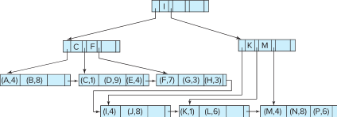

B⁺-Tree File Organization (Cont.)
Example of B+-tree File Organization
Good space utilization important since records use more space than pointers.
To improve space utilization, involve more sibling nodes in redistribution during splits and merges
  Involving 2 siblings in redistribution (to avoid split / merge where possible) results in each node having at least entries

Slide 51
Other Issues in Indexing
Record relocation and secondary indices
  If a record moves, all secondary indices that store record pointers have to be updated
  Node splits in B⁺-tree file organizations become very expensive
  Solution: use search key of B⁺-tree file organization instead of record pointer in secondary index
    Add record-id if B⁺-tree file organization search key is non-unique
    Extra traversal of file organization to locate record
      Higher cost for queries, but node splits are cheap

Slide 52

B⁺-Tree Index
Id | Name | Dept. | Salary

Slide 53
B⁺-Tree Index
A B⁺-tree is a rooted tree satisfying the following properties:
All paths from root to leaf are of the same length
Each node that is not a root or a leaf has between ⎡n/2⎤ and n children.
The search-keys in a node are ordered

Slide 54
B+ Tree
Non leaf nodes form a multi-level sparse index on the leaf nodes. For a non-leaf node with m pointers:
  All the search-keys in the subtree to which P₁ points are less than K₁
  For 2 ≤ i ≤ n – 1, all the search-keys in the subtree to which P_{i} points have values greater than or equal to K_{i–1} and less than K_{i}
  All the search-keys in the subtree to which P_{n} points have values greater than or equal to K_{n–1}
 | 15
3 |  | 6
15 |  | 40
45 |  | 60
To file
To file
To file
To file

Slide 55
B+ Tree
Question 4-2: Find the search key values for the following B+ tree. What is the value of n? How can you find all records of type = 6?
 | 15
3 |  | 6
15 |  | 40
To file
To file
To file
To file

Slide 56
Example of B⁺-Tree
Problem to solve - 6
Given B+ tree index on name attribute. How the following query will be executed?
Select *
From instructor
Where name = ‘Gold’
Id | Name | Dept. | Salary

